Slide 1
OBJECT ORIENTED METHODOLOGIES
PROJECT EVALUATION , SEMESTER-III
BANK MANAGEMENT SYSTEM
Submitted To
Dr. Ranjana Vyas
Dr. OP Vyas
Dept. of Information Technology

Slide 2
GROUP MEMBERS
Section A
ANKUSH SONKER (IIT2019072)
AJAY NIKHIL (IIT2019075)
ANIRUDH SIMHACHALAM (IIT2019068)

Slide 3
A BRIEF INTRODUCTION
What This Project can Do ?
Open new Account
Apply for Loan
Transactions like Deposit, Withdraw, Transfer, Pay Bill.
Bank admin can print user report
Customer can use ATM Services
Allowing to login/logout
Closing a account

Slide 4
TOOLS AND TECHNOLOGIES USED
JAVA Development Tools Required
JAVA Swing Technology
Abstract Window Toolkit (AWT)
IDE : Any Java Development IDE ( we used Eclipse)
JRE : We used JAVA SE 1.8

Slide 5
PROJECT DESCRIPTION
This Project contains 16 JAVA classes
Project Folder name : BANKING MANAGEMENT SYSTEM
Authentication.java
CustomerLogin.java
EmployeeLogin.java
ATMAuthentication.java
Account.java
Data.java
Database.java
CreateAccount.java
CustomerDashboard.java
ATM.java
EmployeeDashboard.java
Help.java
LoanAccount.java
LoanApplication.java
LoanDashboard.java
SavingAccount.java

Slide 6
INSTRUCTION FOR EXECUTION
To Run the project follow:
→ Extract Zip folder BANKING MANAGEMENT SYSTEM.zip
→ Open Project with IDE
→ Open Authentication.java class from src folder
→ Run that class

Slide 7
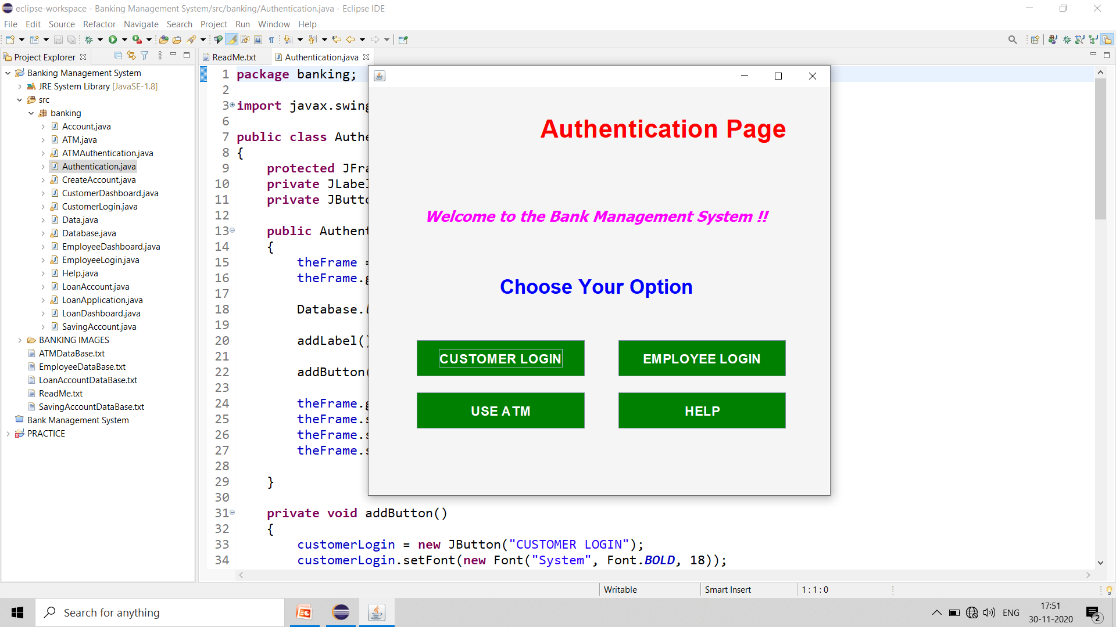
Authentication.java
Authentication.java is the main driver class which starts the project.
It provides the interface to the user to login as customer or employee.

Slide 8
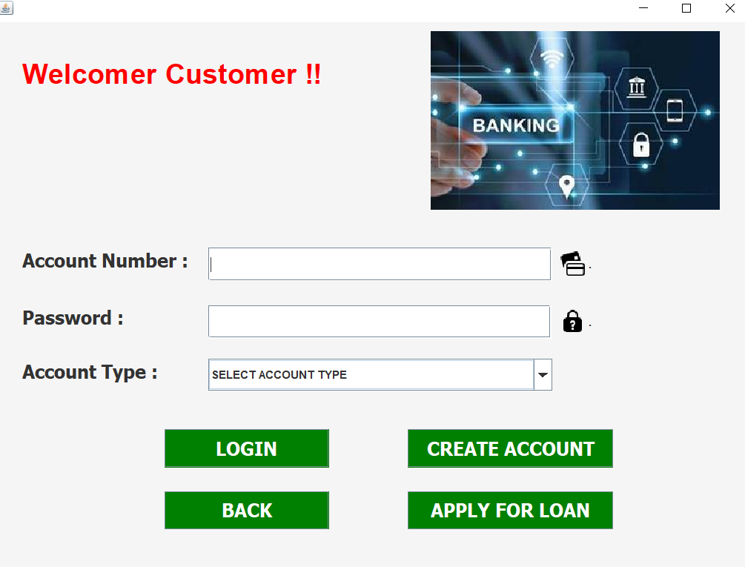
CustomerLogin.java
Enter Account No. and Password and login.

Slide 9
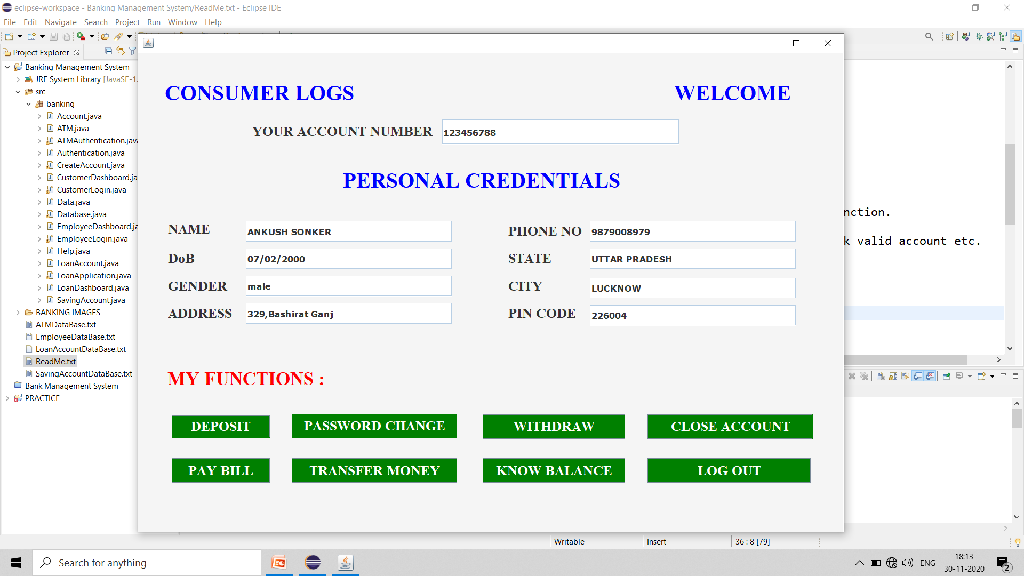
If Account No. and Password valid , will let you see following .
Click LOG OUT button to logout.

Slide 10
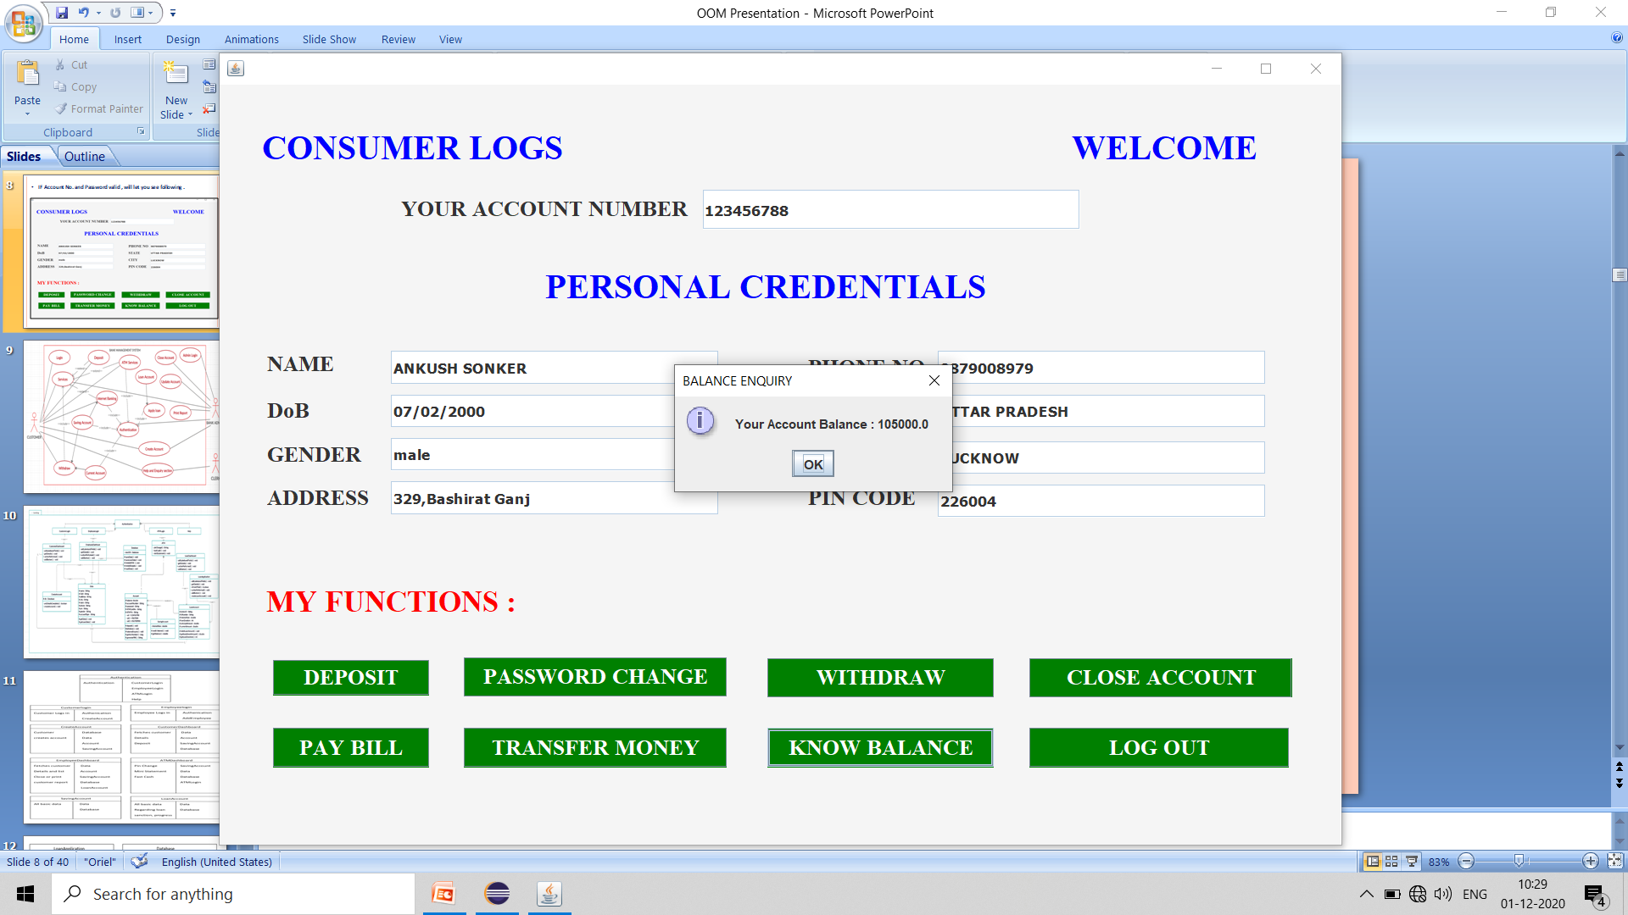
Click KNOW BALANCE Button. It will display current account balance .
Use other button for other services .

Slide 11
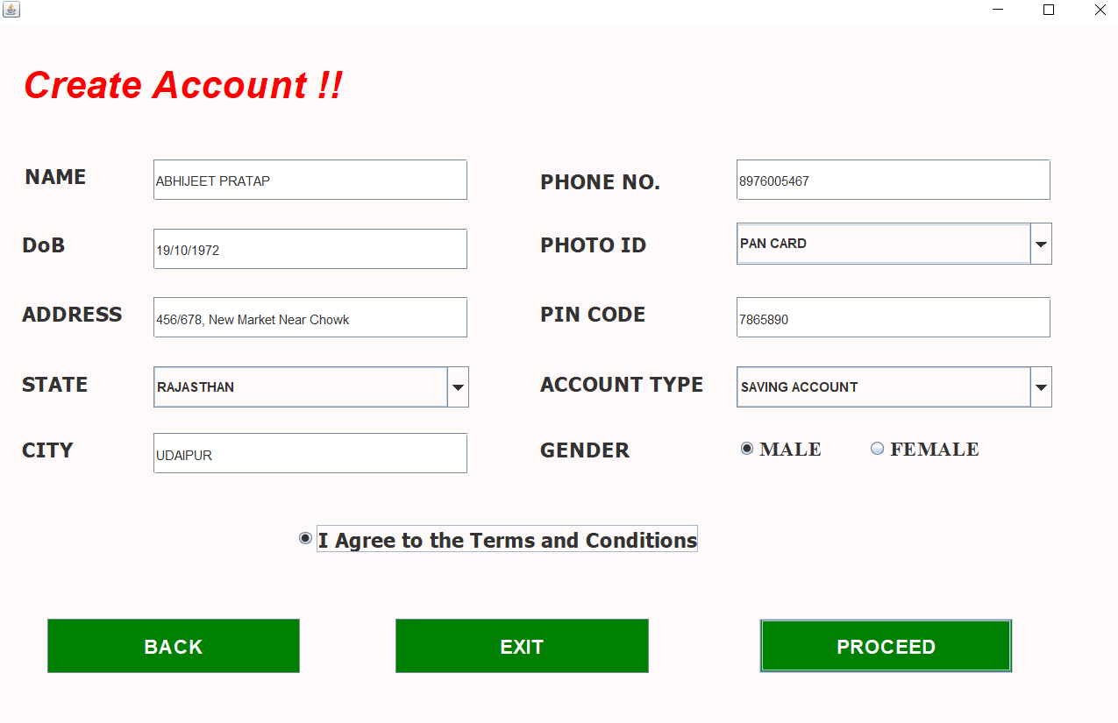
Fill the details and click PROCEED button .

Slide 12
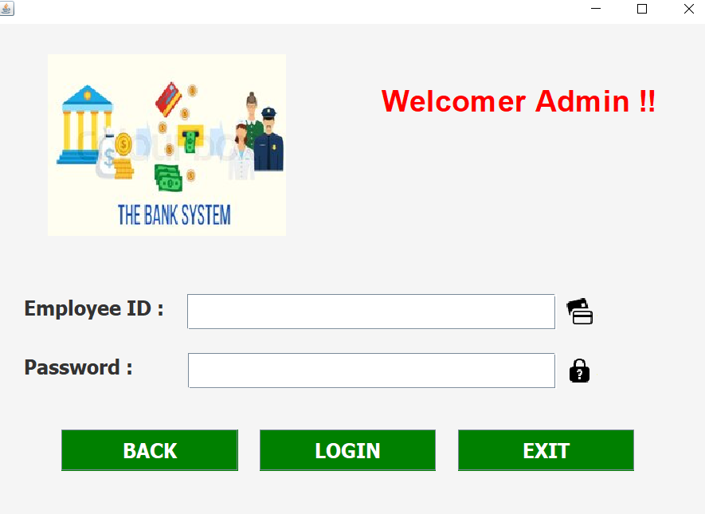
EmployeeLogin.java
EmployeeLogin.java is a class which allows bank admin to access Database.
Enter Employee ID and Password.

Slide 13
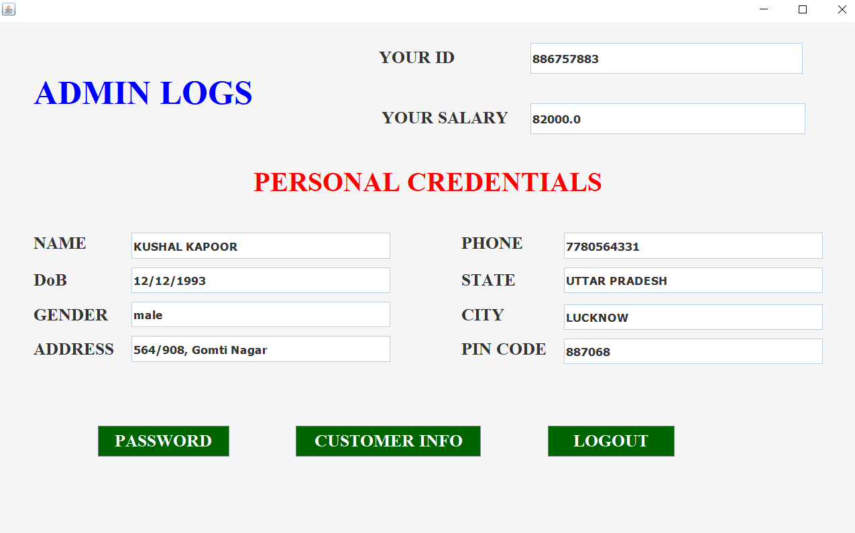
Following page is displayed .
Use buttons provided for different services .

Slide 14
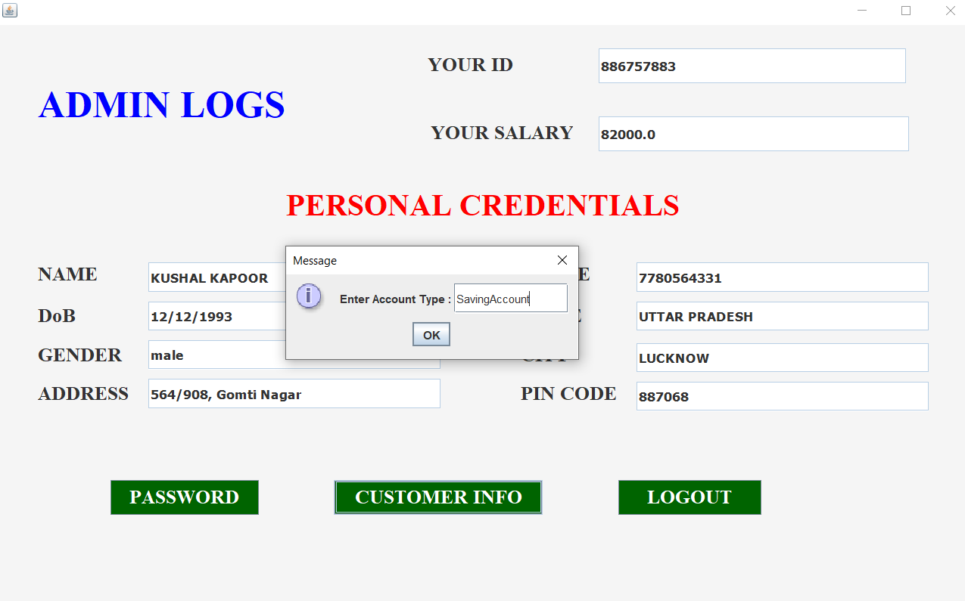
Click CUSTOMER INFO Button. It asks for Account Type. Enter SavingAccount or LoanAccount without space in between and see

Slide 15
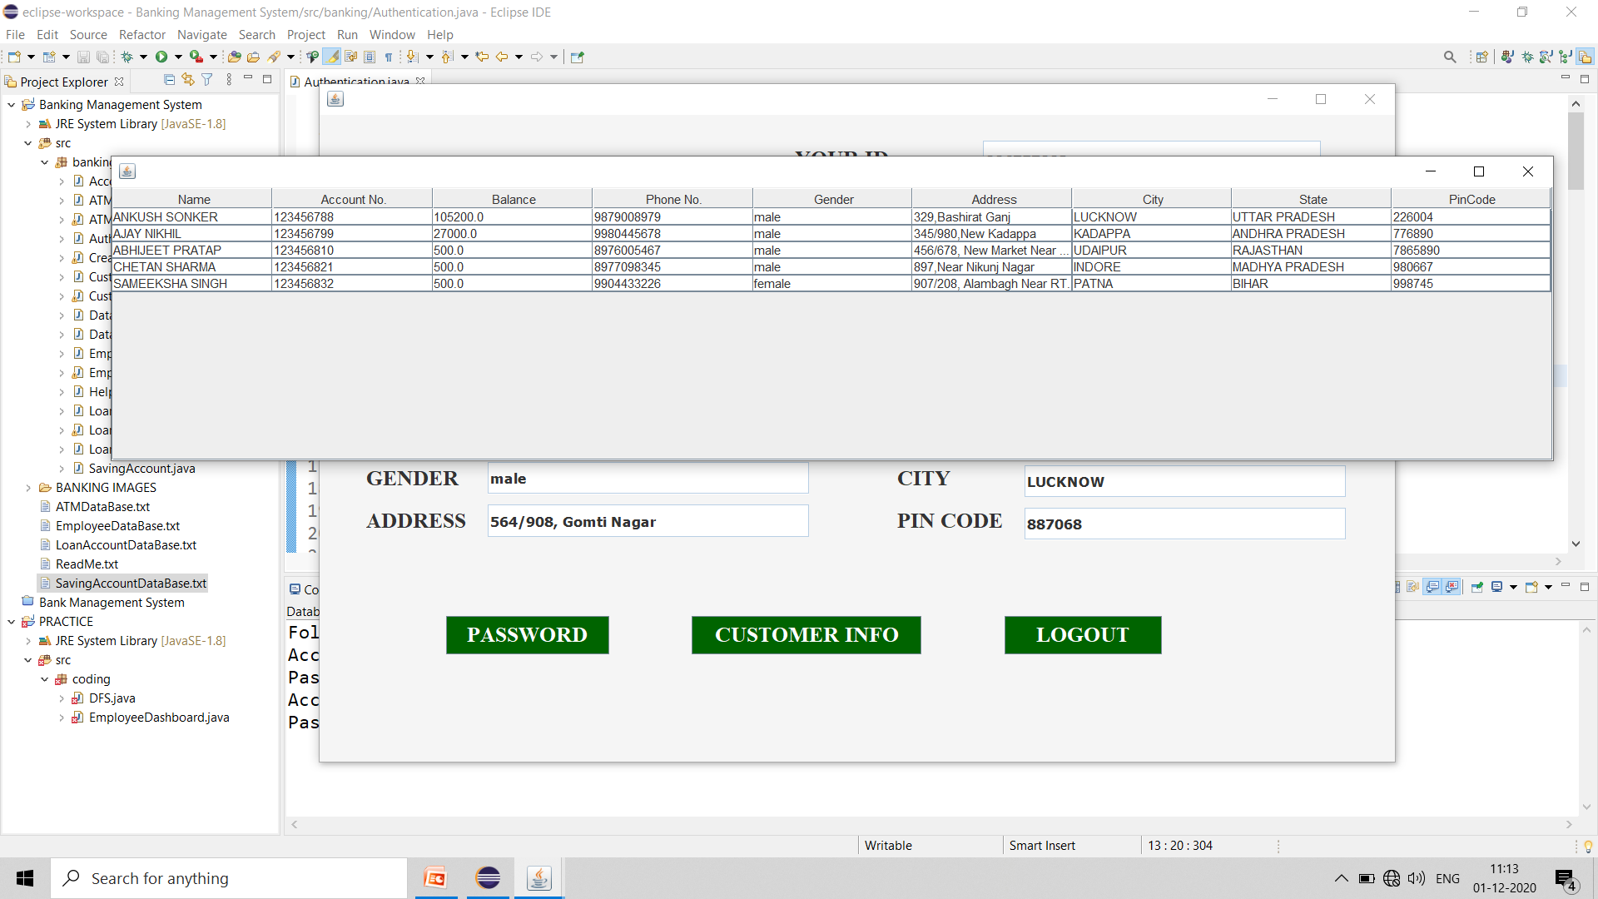
Customer Report in Tabular Form

Slide 16
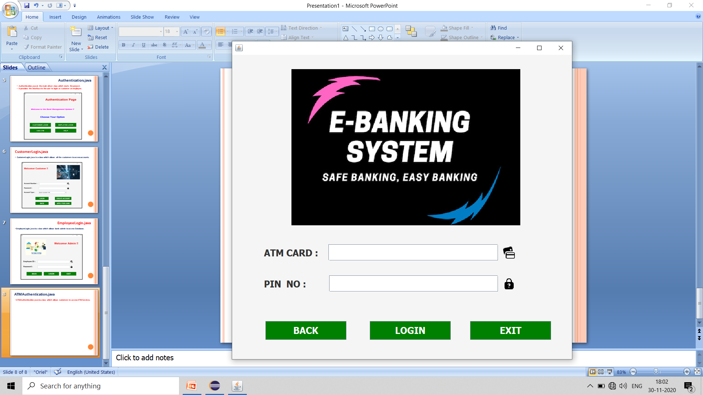
ATMAuthentication.java
Enter ATM Card Number and Password.

Slide 17
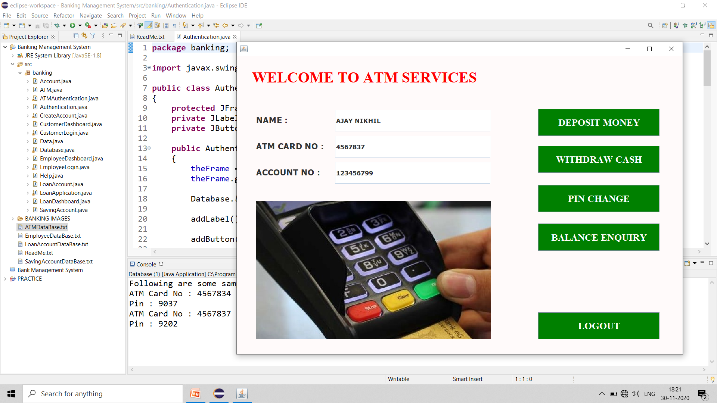
ATM.java
ATM.java is a class displaying ATM info after the customer logs in.

Slide 18
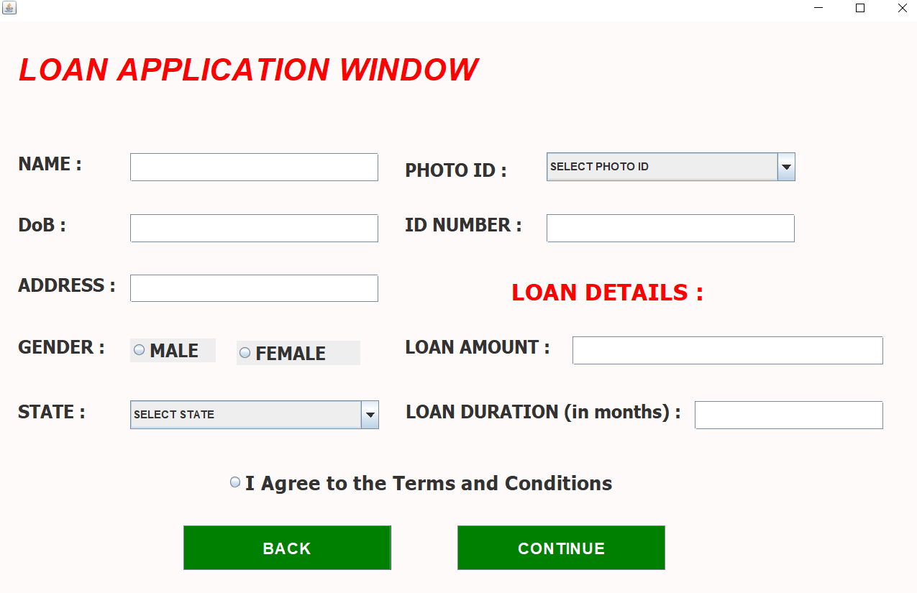
LoanApplication.java
LoanApplication.java is a class which allows user to apply for loan.

Slide 19
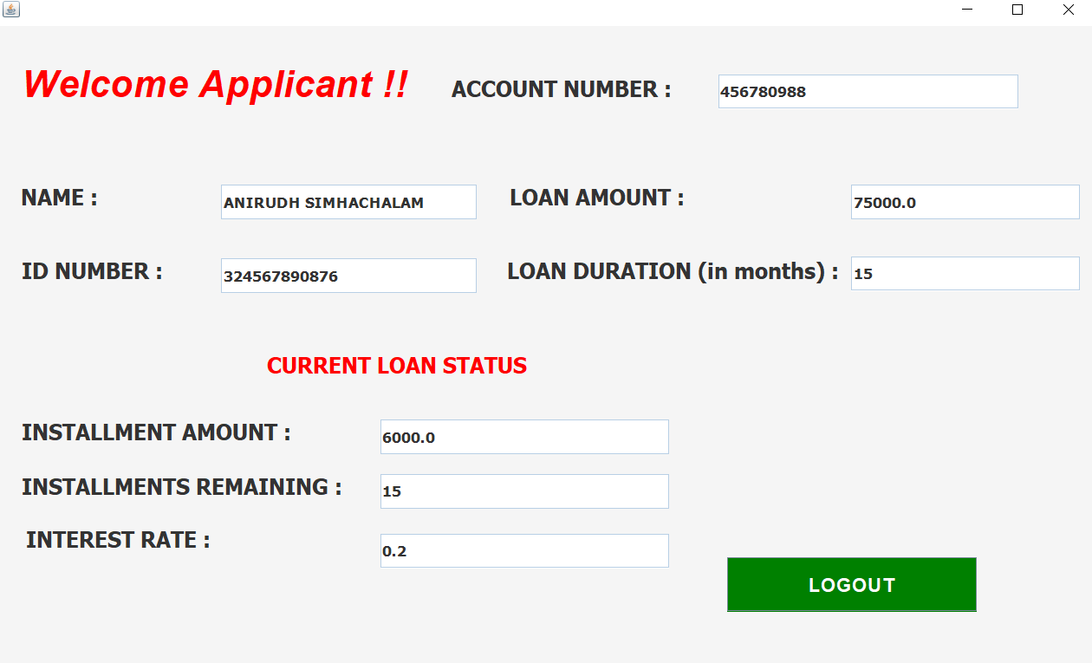
LoanDashboard.java
LoanDashboard.java displays the details of the customer regarding loan details.

Slide 20
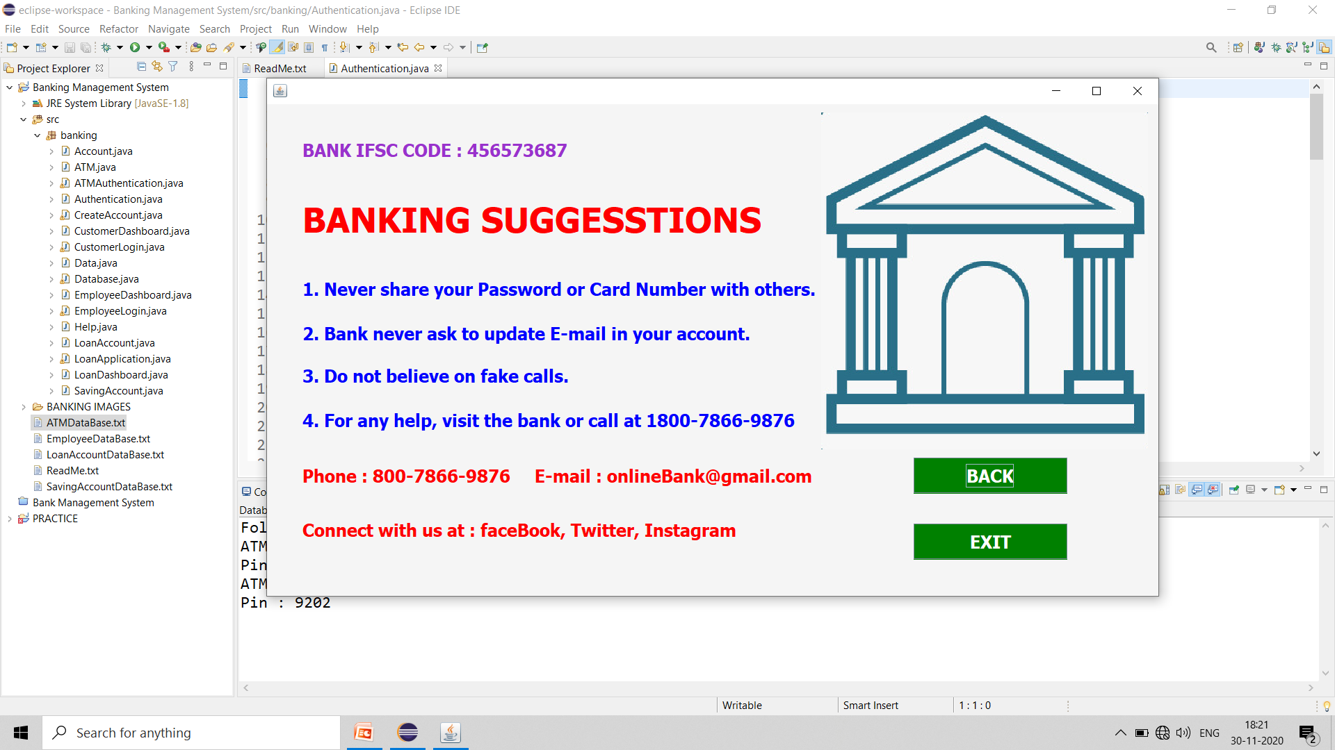
Help.java
Help.java is a general purpose helping class.

Slide 21
FILE HANDLING : FILES AS DATABASES
SavingAccountDataBase.txt
LoanAccountDataBase.txt
ATMDataBase.txt
EmployeeDataBase.txt
SavingAccountDataBase.txt is used to store data of all the customers having saving account in the bank.
LoanAccountDataBase.txt is used to store data of all the customers who have taken loan from the bank.
ATMDataBase.txt is used to store the ATM related data of the customer.
EmployeeDataBase.txt is used to store the data of all the employees and the entire administration of the bank.

Slide 22
THE HEART OF THE PROJECT : Database.java
It contains everything and every functionality of the project !!
It links the java classes with the database.
It loads database in ArrayLists to be used by the user.
It allows us to modify customer data like deposit, withdraw,
transfer money, password change, closing the account , balance enquiry, create account, apply for loan.
Bank Admin can print the reports of all the customers.
This class validates the admin and customer login details against the database.
Classes like Account.java and Data.java are the contributing classes in Database.java class for above functionalities

Slide 23
Database
Deposit
Withdraw
Password Change
Close Account
Create Account
Apply for Loan
Balance Enquiry
Print Report

Slide 24
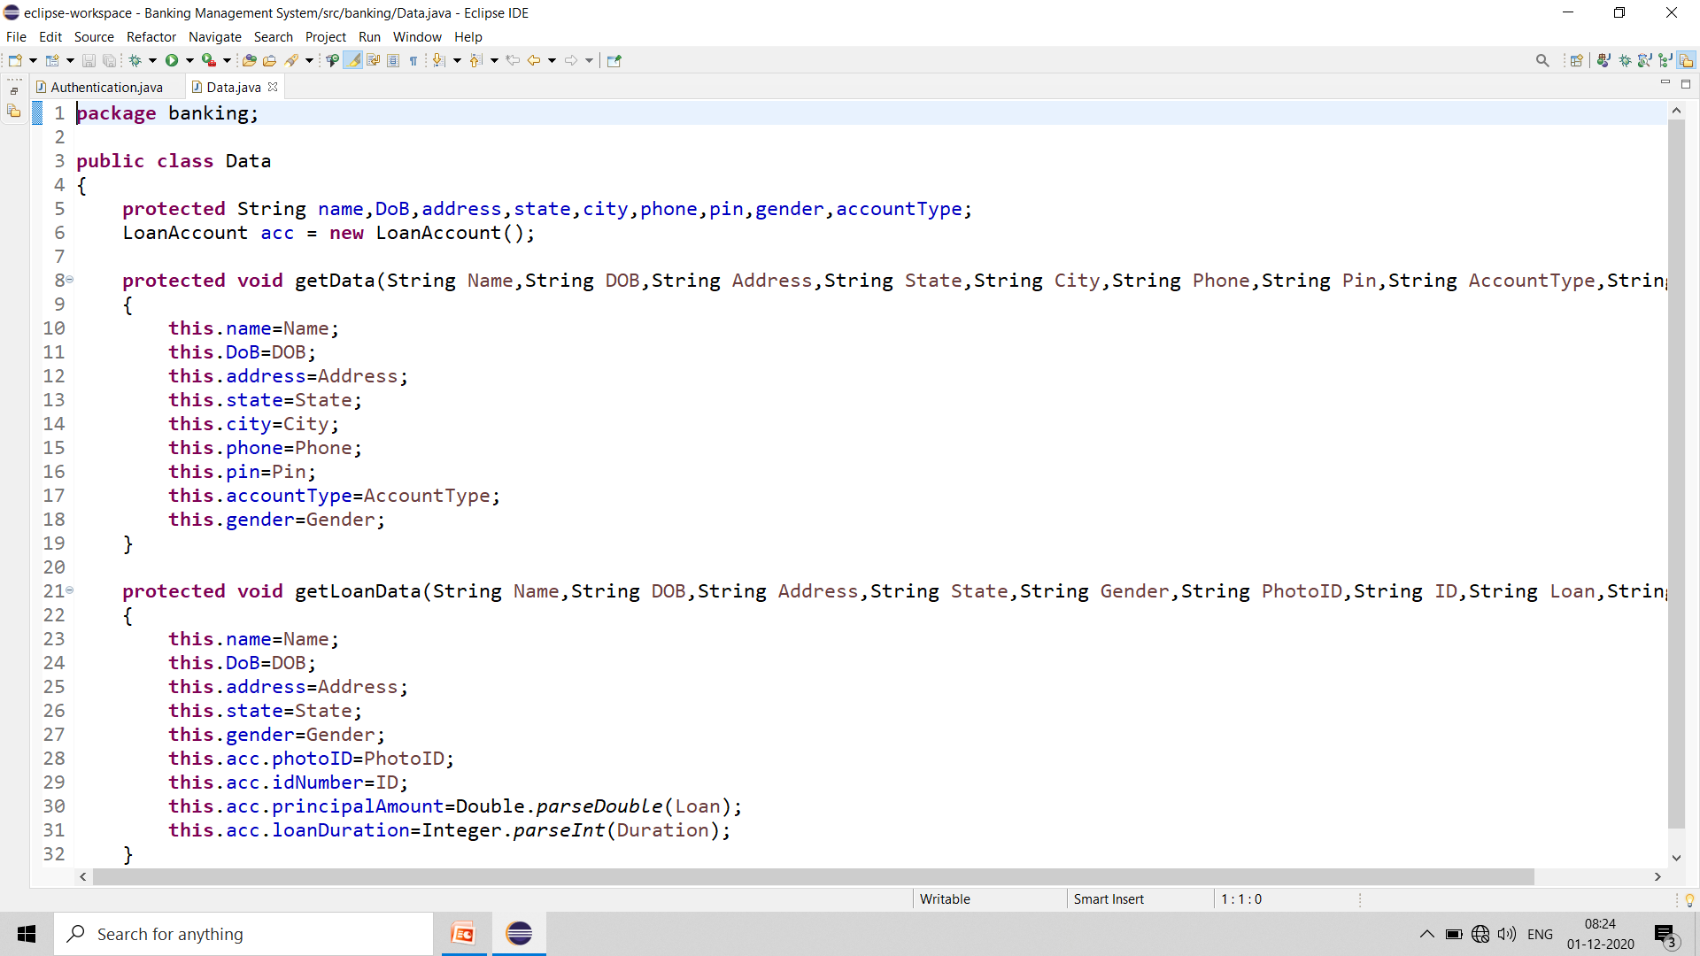
Data.java
This holds all the information of a customer like name, age etc.

Slide 25
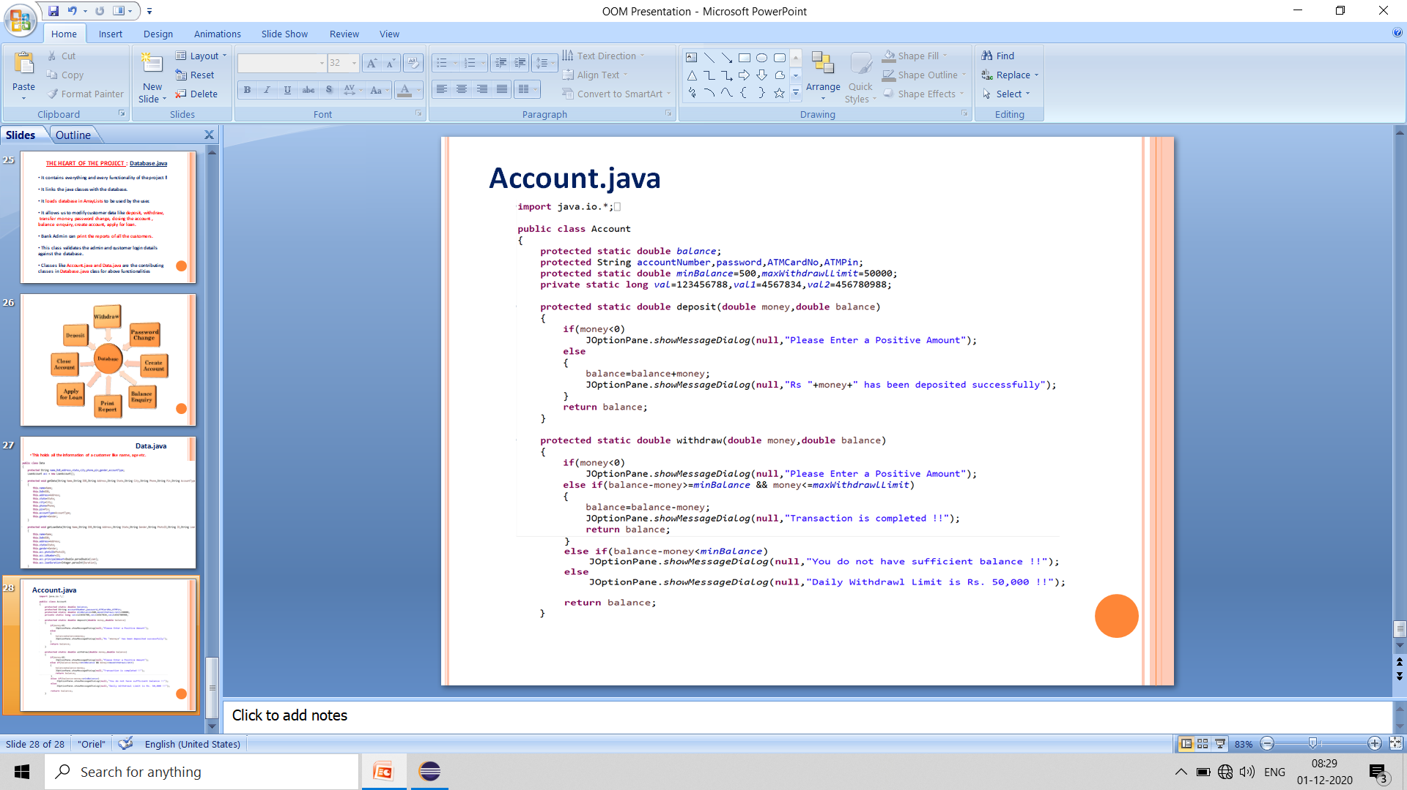
Account.java

Slide 26
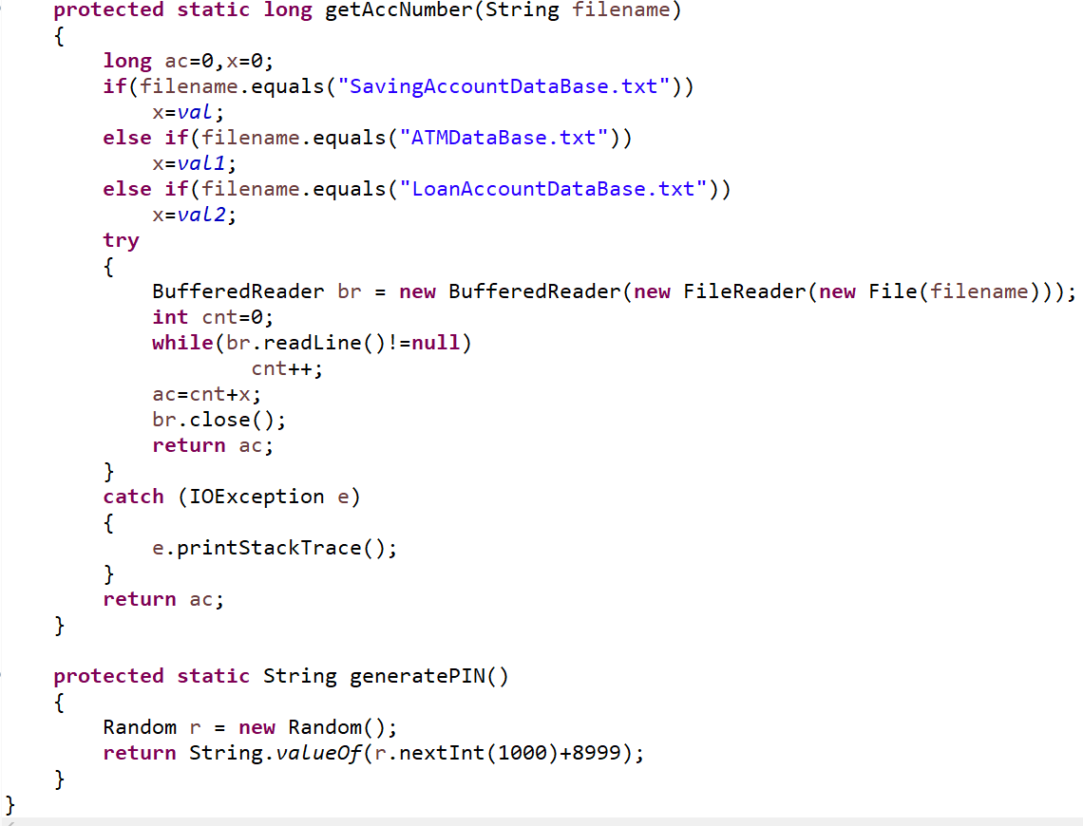

Slide 27
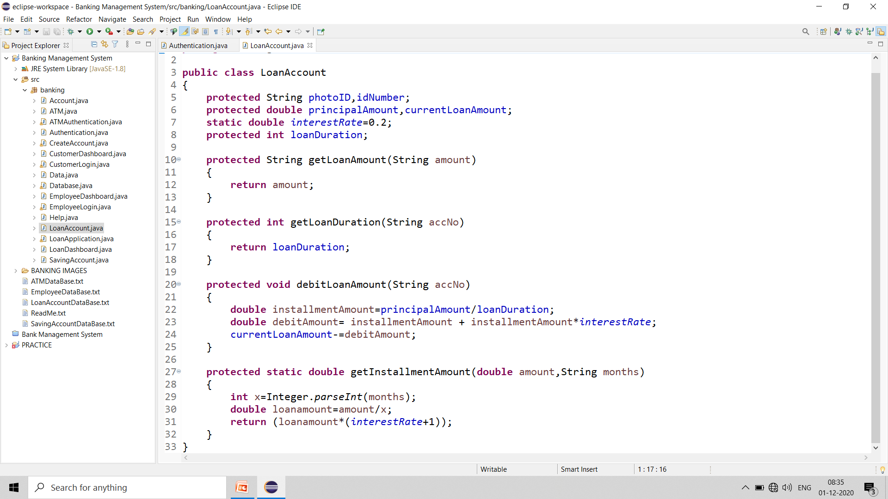
LoanAccount.java

Slide 28
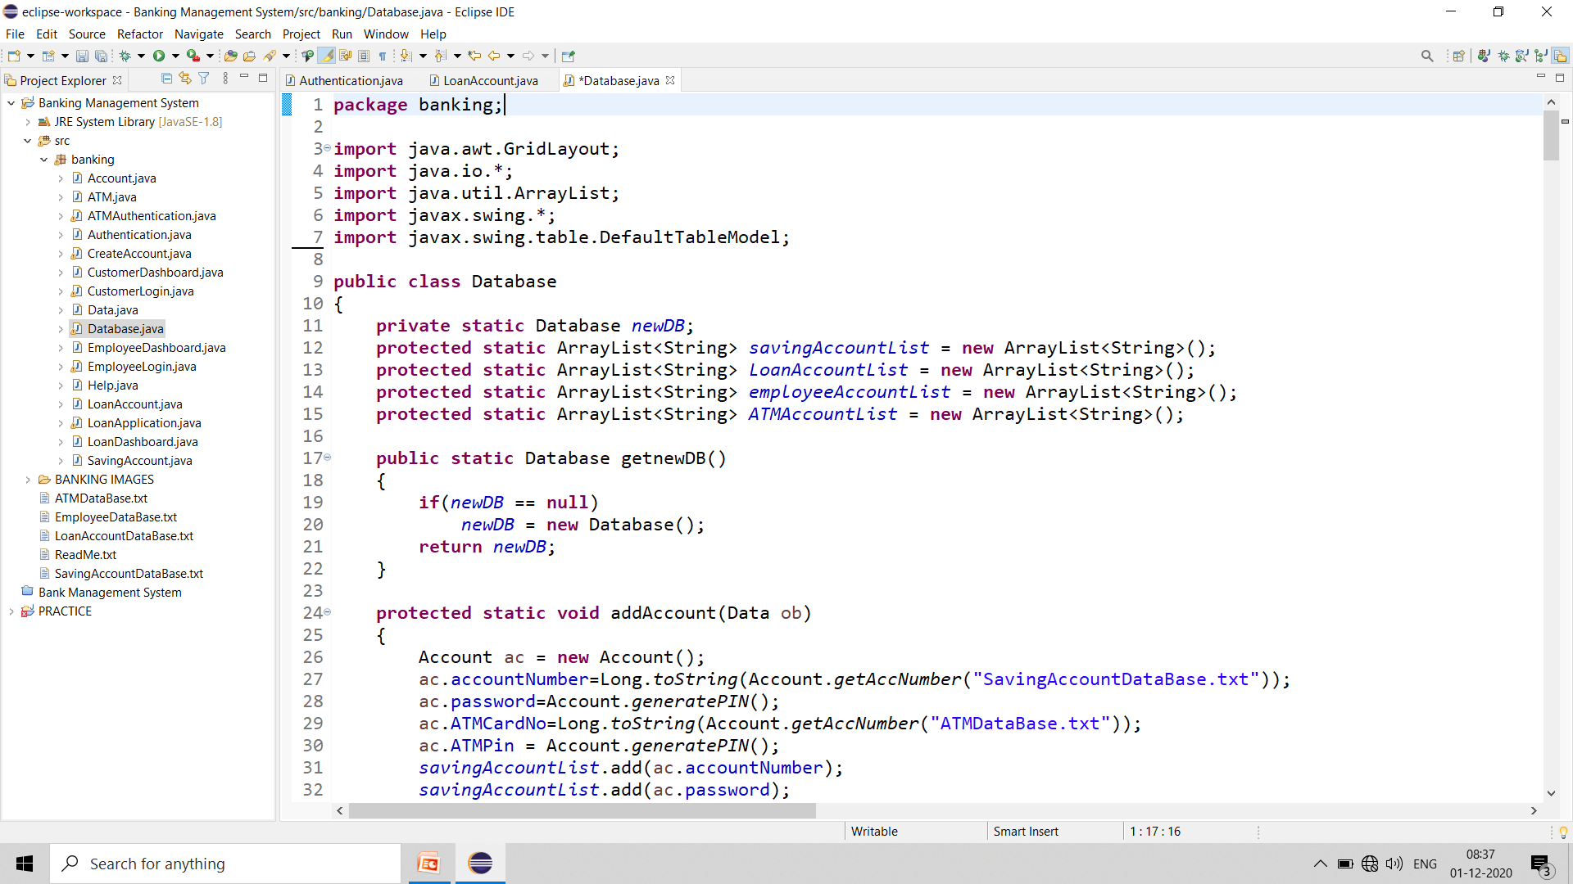
Database.java

Slide 29
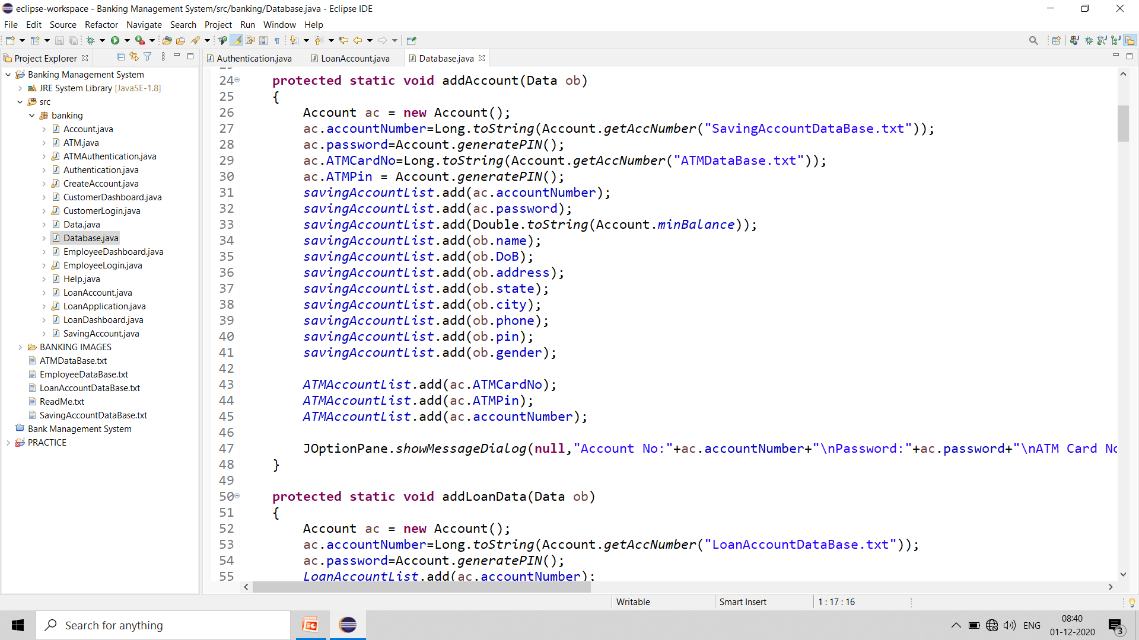

Slide 30
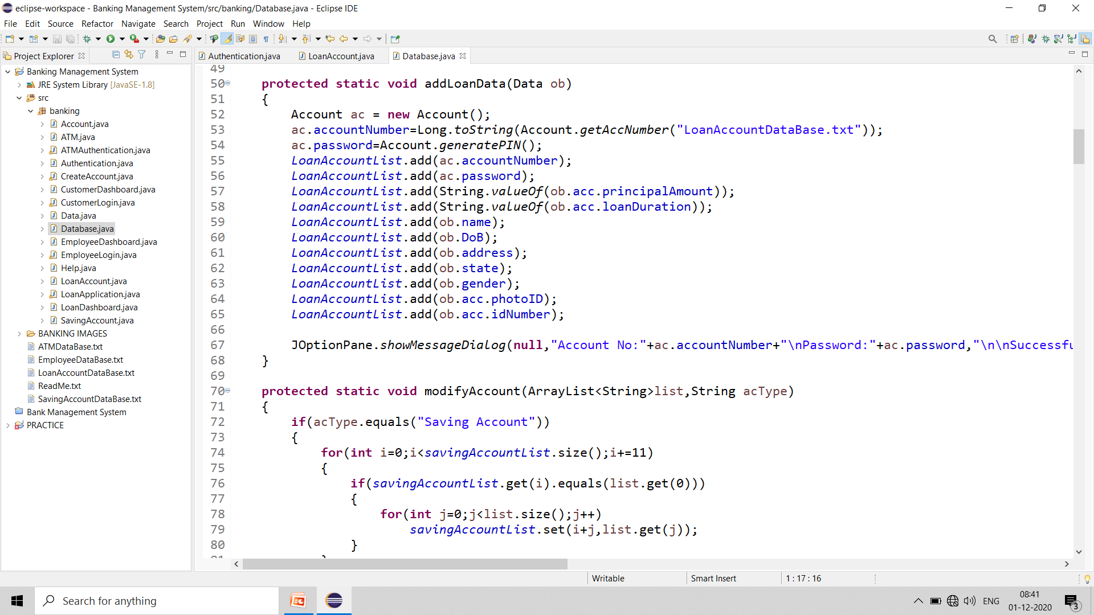

Slide 31
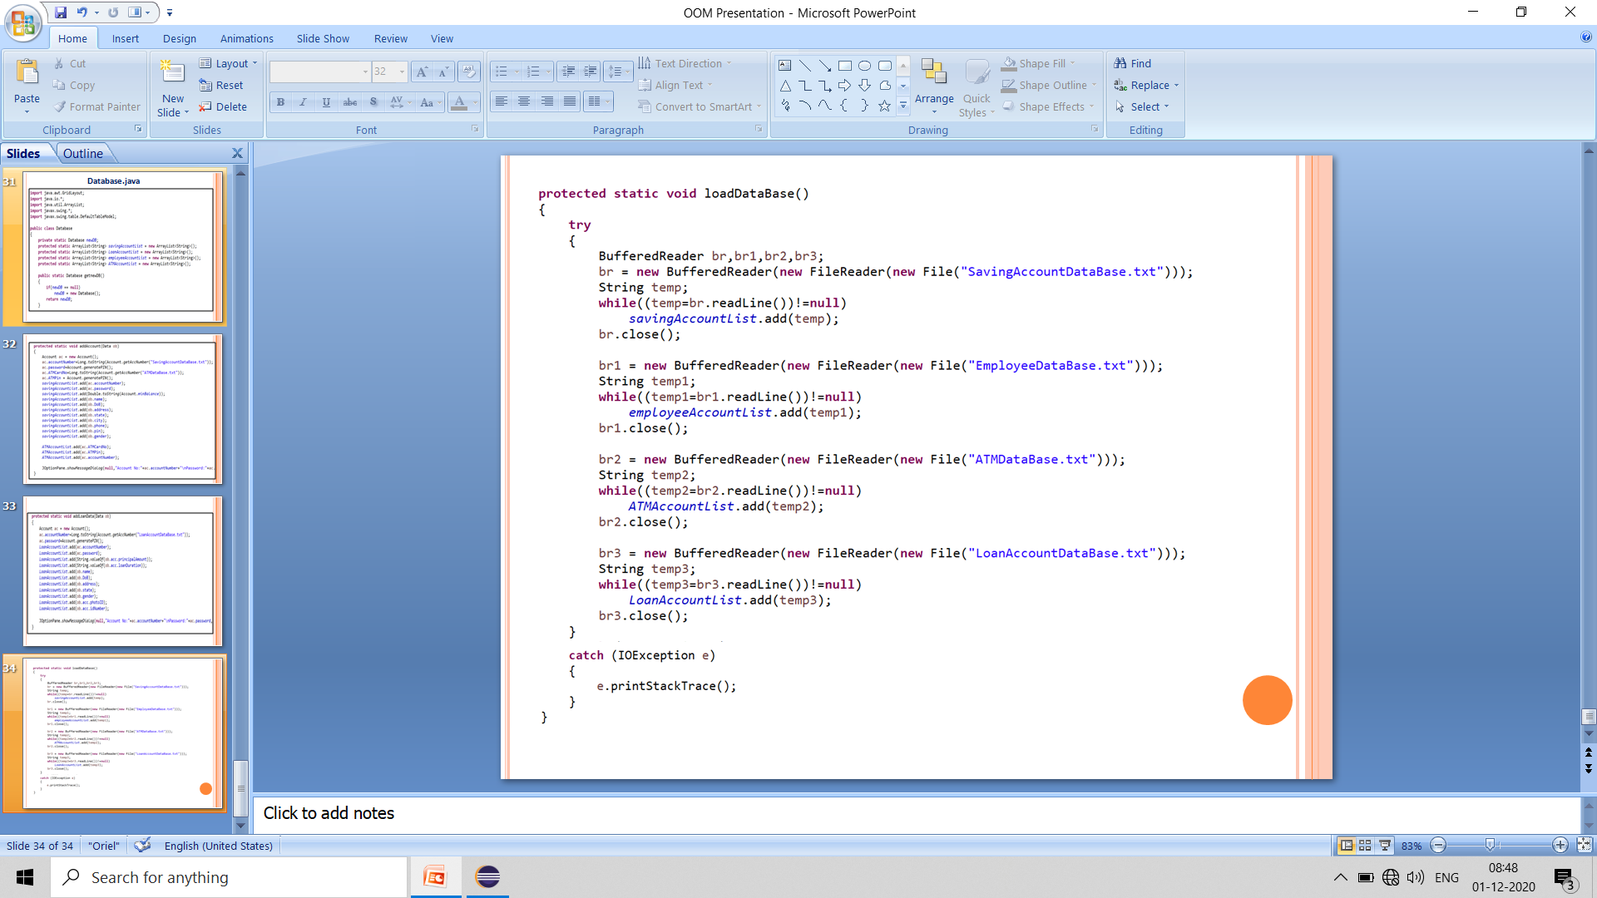

Slide 32
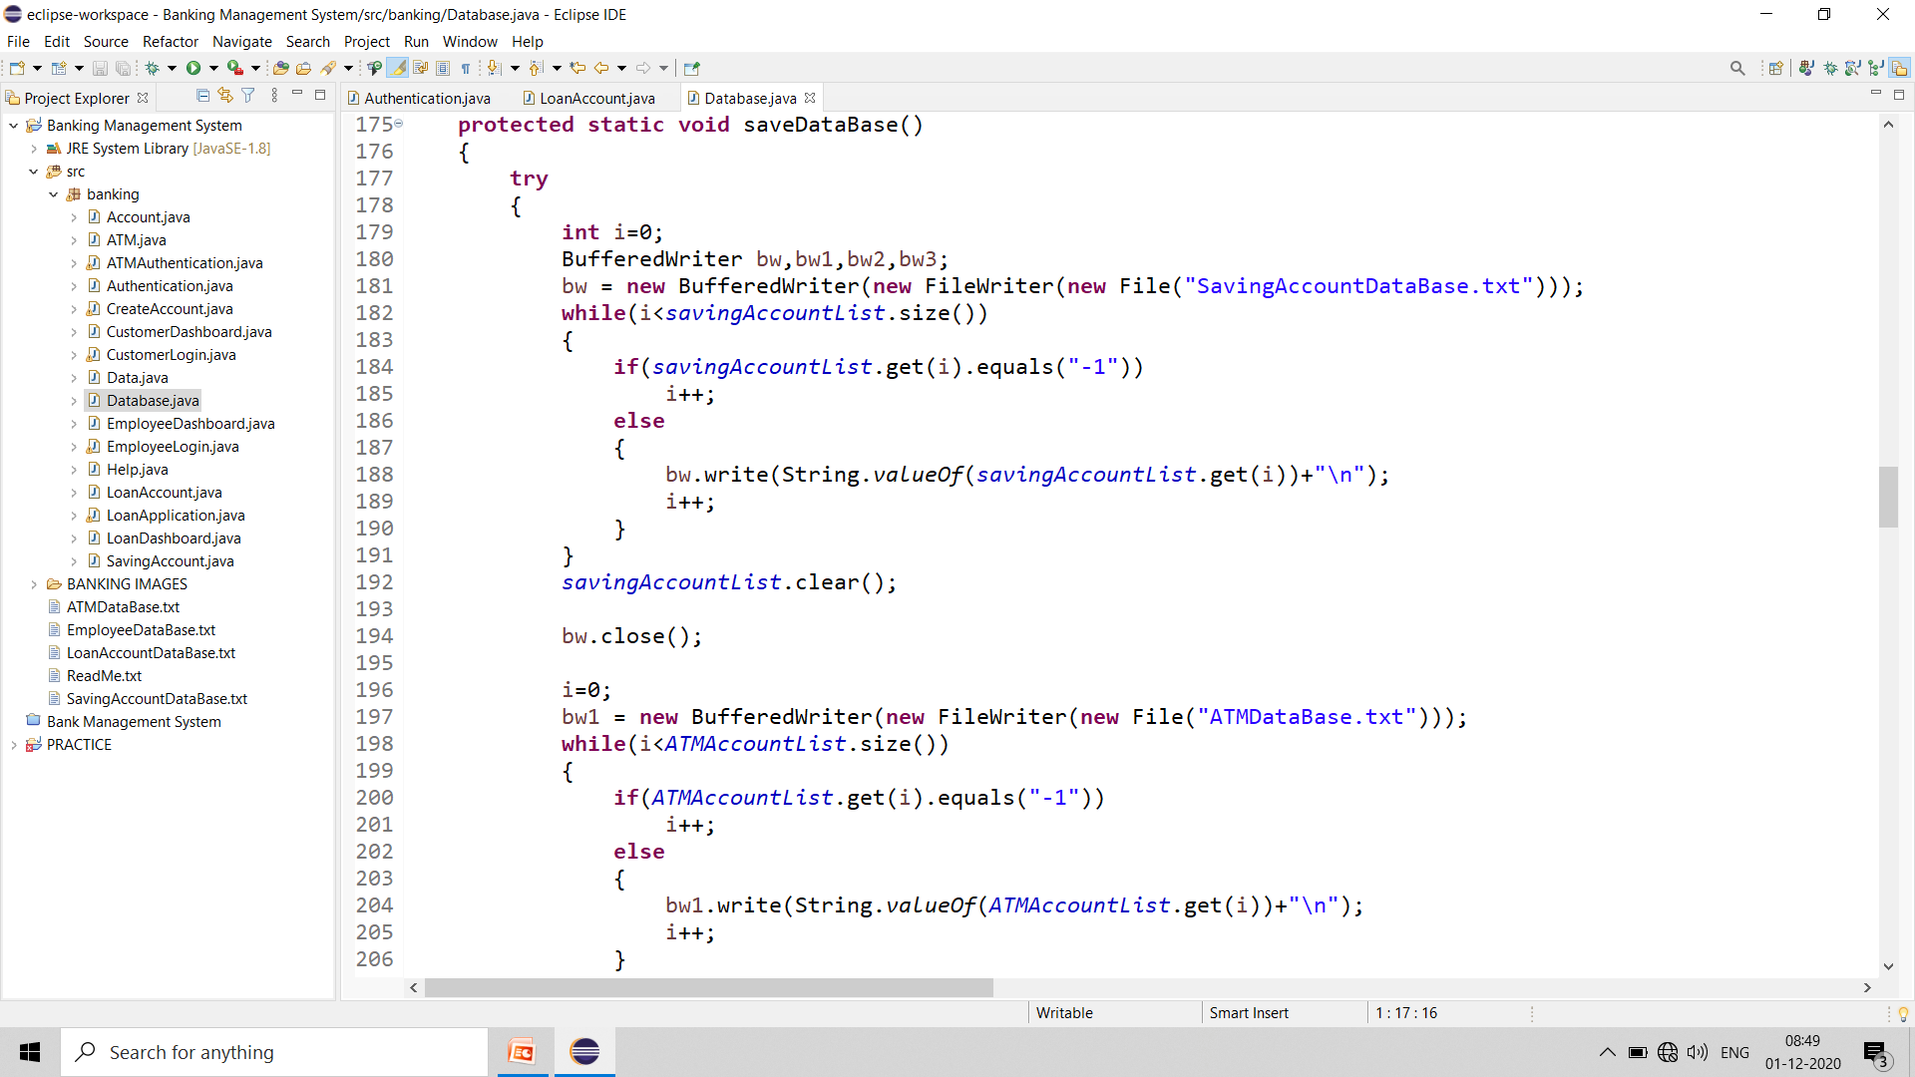
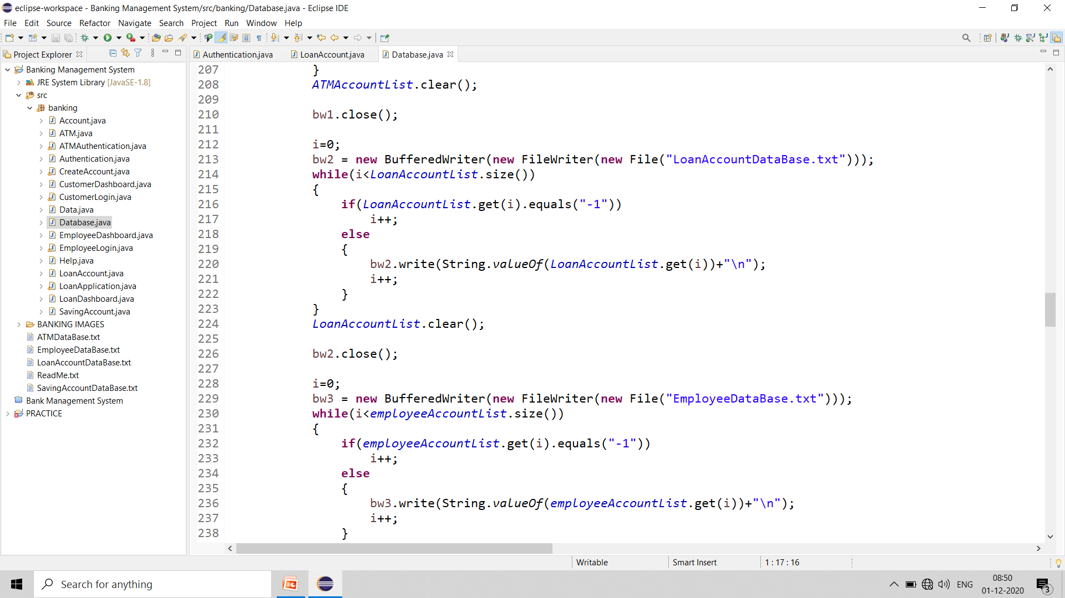

Slide 33
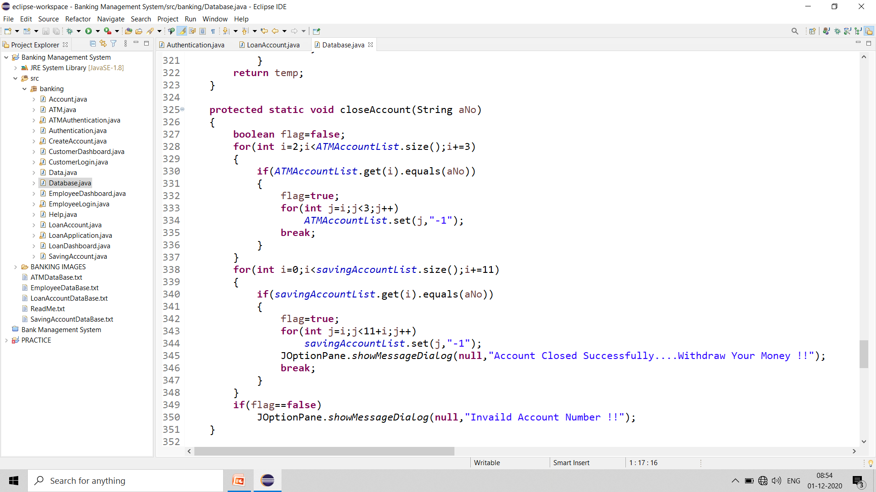

Slide 34
THANK YOU

